Slide 1
Full Stack Web Development
Capstone Presentation

Slide 2
Title Slide
Title:
Subtitle:
Presented by:
Date:
Library Management System (LMS) Capstone Project
Full Stack Web Development Project
Tang Yuzhen
1st April 2025

Slide 3
Project Overview
Introduction:
The Library Management System (LMS) is an automated solution designed to manage library operations efficiently.
Aims to streamline book management, borrowing status, and borrowing/returning processes.
Objective:
To create a digital system that supports librarians and users in managing books and library activities.
Technologies:
MySQL 8.0
Software:
Vite React
Spring Boot
Eclipse
MySQL WorkBench
Visual Studio Code

Slide 4
Project Goals
To have a fully functional web application where:
Efficient Book Management:
Automate the process of adding, updating, anddeleting books.
Enhanced User Experience:
Allow users to borrow and return books, checkbook availability, and search for books.
User-friendly interface:
Clean page with all links presented

Slide 5
Key Features
Book Management:
Add, edit, and delete books.
Search and filter books by title, author, or category.
User Management:
Register, update, and delete users.
Different user roles (Librarian, Member).
Borrow/Return System:
Users can borrow and return books with tracking.
Fine Calculation:
Automatic calculation of fines for overdue books.

Slide 6
Business Rules
Users:
Users can borrow up to 3 books at a time.
Borrowing:
Books must be returned within 14 days. Overdue books incur fines.
Fine Calculation:
Fines are charged based on the number of days the book is overdue.
$0.50 fine per overdue day, capped at $20

Slide 7
Technical Requirements
Frontend:
React.js, React Router, React Hooks, Bootstrap/Material-UI, Axios, CSS.
Backend:
Spring Boot Java.
Database:
Relational database (MySQL) for storing book, user, and transaction data.
RESTful API for communication between frontend and backend.

Slide 8
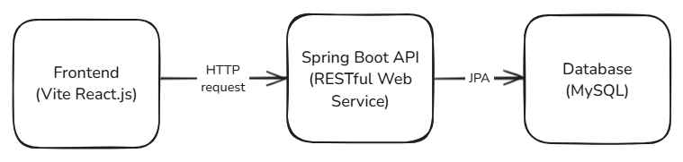
System Architecture
Architecture Type: Model-View-Controller (MVC)
Model: Represents the data and the business logic of the application.
View: The user interface (UI) that displays the data.
Controller: Handles user input and updates the model and view accordingly.

Slide 9
Screenshots of key features
Frontend:
React.js, React Router, React Hooks, Bootstrap/Material-UI, Axios, CSS.
Backend:
Spring Boot Java.
Database:
Relational database (MySQL) for storing book, user, and transaction data.
RESTful API for communication between frontend and backend.

Slide 10
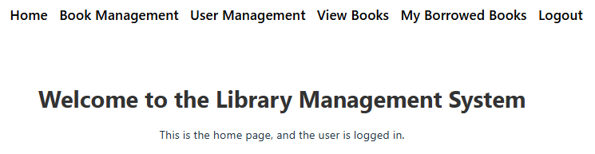
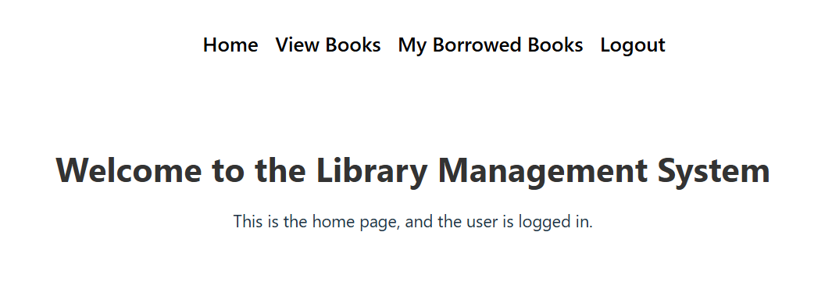
Screenshots of key features – Homepage
Librarian Homepage
Home
Book Management
User Management
View Books
My Borrowed Books
Logout
Member Homepage
Home
View Books
My Borrowed Books
Logout

Slide 11
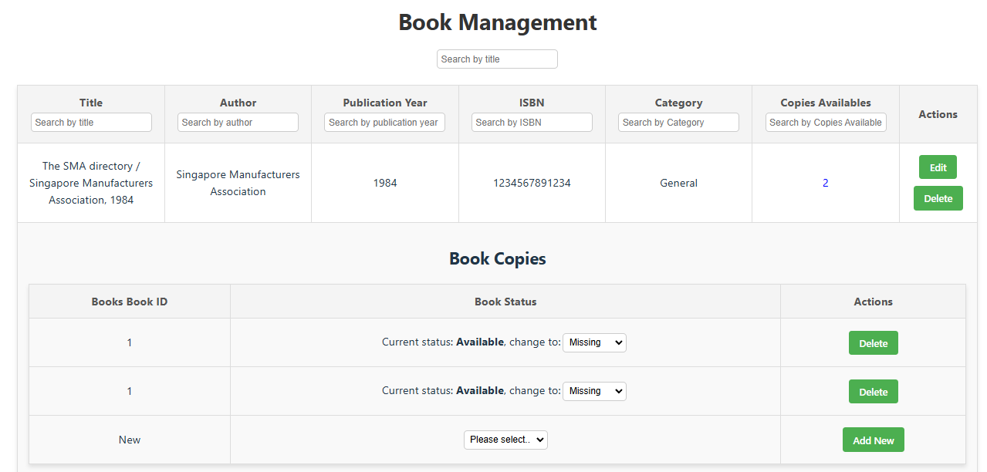
Screenshots of key features-Book Management
Book Management

Slide 12
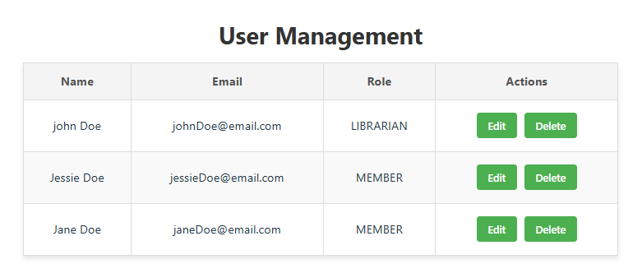
Screenshots of key features-User Management
User Management

Slide 13
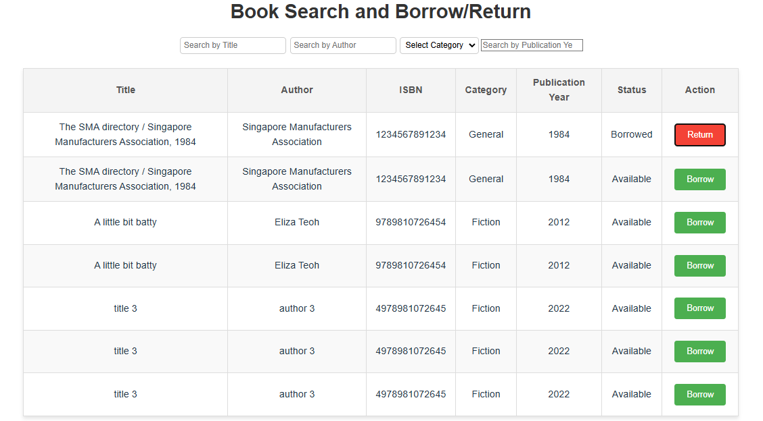
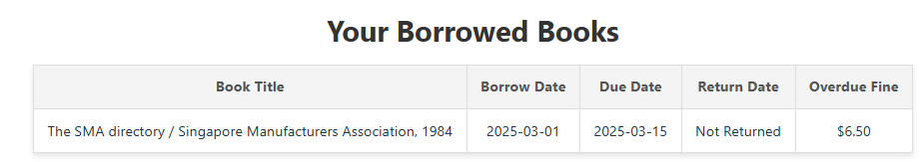
Screenshots of key features-Books
View Books
My Borrowed Books

Slide 14
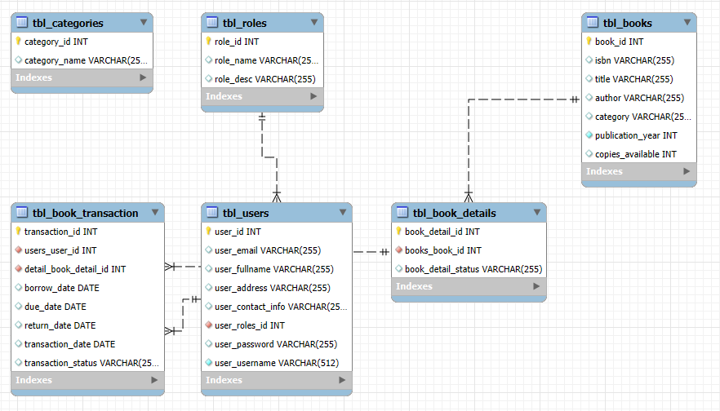
Database & System Designs

Slide 15
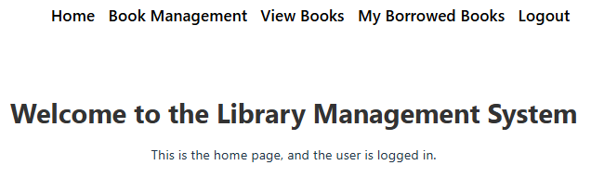
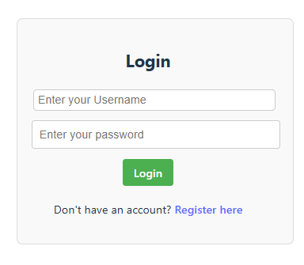
Database & System Designs

Slide 16


API endpoints

Slide 17
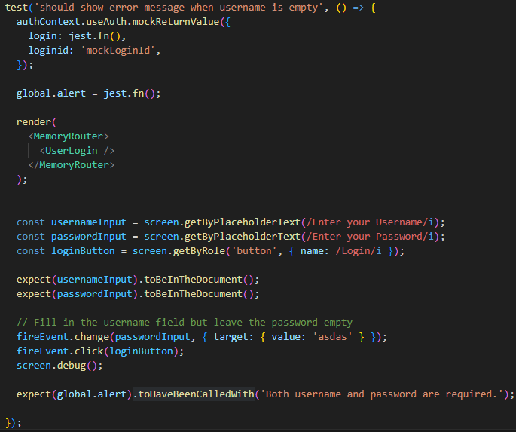
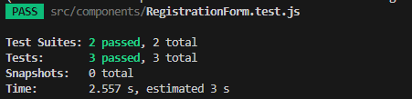
Test Cases - UATs
Test Cases are create for User Acceptance Testing.
e.g 1
Test Case 1: User Login
Objective: Ensure users can log in successfully.
Steps: Enter valid credentials, click login.
Expected Result: User is directed to the dashboard.
Jest test are also used to test on the frontend
e.g 1

Slide 18
Challenges and Solutions
Mention about:
Integrating frontend and backend.
Implementing role-based access control.
Handling fine calculation and overdue books.
Ensuring data validation and security.
Presentation Hints:
Discuss the challenges encountered during the project.
Explain how these challenges were overcome.

Slide 19
Future Enhancements
Reservation functionality
Advanced Reporting
Mobile App
Integration with other library branches
Allow members to reserve the books
To collaborate with other branches to get their information on the Book informations.
To allow members to have the same functionalities for other branches books
To show reporting on the most borrowed book or most searched authors.
Creating a mobile app as it is easier to access rather accessing from url.

Slide 20
Conclusion
The Library Management System streamlines the day-to-day activities of libraries, making it easier for librarians and members to manage books and transactions.
The system will improve operational efficiency, enhance user experience
Future enhancements will further expand its capabilities, making it a scalable and robust solution for modern libraries.

